Slide 1
MULESOFT QUIZ QUESTIONS

Slide 2
Quiz Rules
The quizzes consists of questions carefully designed to help you self-assess your comprehension of the information presented on the topics covered in the module.
Each question in the quiz is of multiple-choice format
The quiz will consist of 3 questions.
Each question will generally have four options, and participants must choose the correct answer.
You can only submit your answers once.
For each question, we will select three candidates with the correct answers, and then we will randomly select one from the top three with the help of an online tool.
Participants will earn points for each correct answer, and the winner will be chosen at the final session.
The top 3 participants will be chosen based on the number of right questions answered, and then we will randomly choose one lucky winner from the top 3.
We will be maintaining all the participants ranks with us.
For each question, there will be only one participant who gives the fastest right answer, and they are not allowed to give multiple answers to the same question.

Slide 3
Day 10

Slide 4
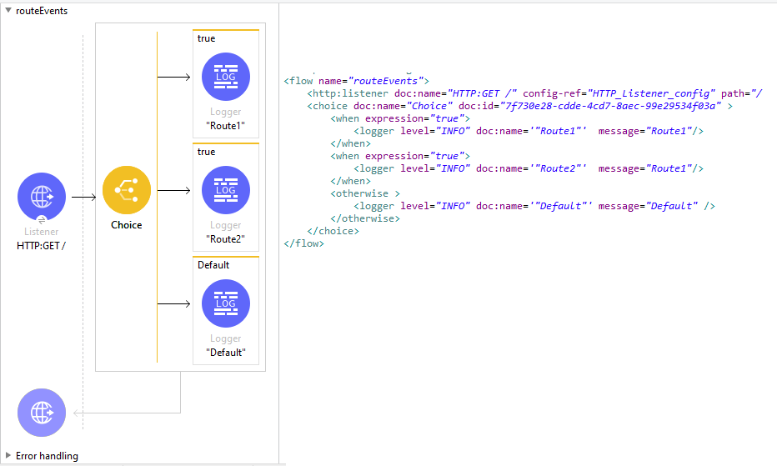
1. Refer to the exhibits. All three of the conditions for the Choice Router are true. What log messages are written ?
Route 1
Route 2
Route 1, Route 2
Route 1, Route 2, Default
Answer: A

Slide 5
2. In the execution of the Scatter-Gather, the flow1 route complete after 10 Seconds and the flow2 route completes after 20 seconds. How many seconds does it take for the Scatter-Gather to complete ?
0
10
20
30
Answer: C

Slide 6
3. What execution model is used by For Each and Batch Job scopes?
Both are multi-threaded
Both are single-threaded
Batch Job is single-threaded and For Each is multi-threaded
For each is single-threaded and Batch Job is multi-threaded
Answer: D

